Slide 1

Predicting Solar Energy Consumption with Machine Learning
This presentation explores how machine learning enhances solar energy forecasts. Accurate predictions aid energy management and grid integration. Join us to understand the future of solar power.

Slide 2




The Need for Solar Energy Forecasting
Variable Generation
Solar generation is affected by irradiance, weather, and seasonality.
Balance Supply & Demand
Accurate forecasts enable balancing energy supply and demand.
Grid Integration
Forecasting is critical for efficient solar grid integration.
Solar energy output is inherently variable. Understanding and predicting this variability is crucial for effective energy management and smooth integration into the existing electrical grid infrastructure. Without precise forecasts, grid operators face challenges in maintaining stability.

Slide 3




Data Requirements for ML Solar Forecasting
Collect Data
Historical power, weather, AQI, and irradiance data are essential.
Pre-process Data
Remove outliers, normalize, and handle missing values for quality.
Select Features
Temperature, humidity, wind, clouds, and AQI are key.
High-quality data is the foundation of accurate ML models. Comprehensive historical data points, including environmental factors, are necessary inputs. Rigorous data cleaning and feature engineering prepare the data for model training.

Slide 4



ML Approaches to Solar Energy Prediction
Traditional ML
Deep Learning
Ensemble Models
Linear Regression, gradient boosting, and Random Forest are used.
ConvLSTM2D and LSTM models excel in time series forecasting.
Combining multiple predictors significantly boosts overall accuracy.
A variety of machine learning techniques can be applied. Traditional methods offer interpretability, while deep learning models capture complex temporal patterns. Ensemble approaches leverage the strengths of diverse algorithms for superior performance.

Slide 5

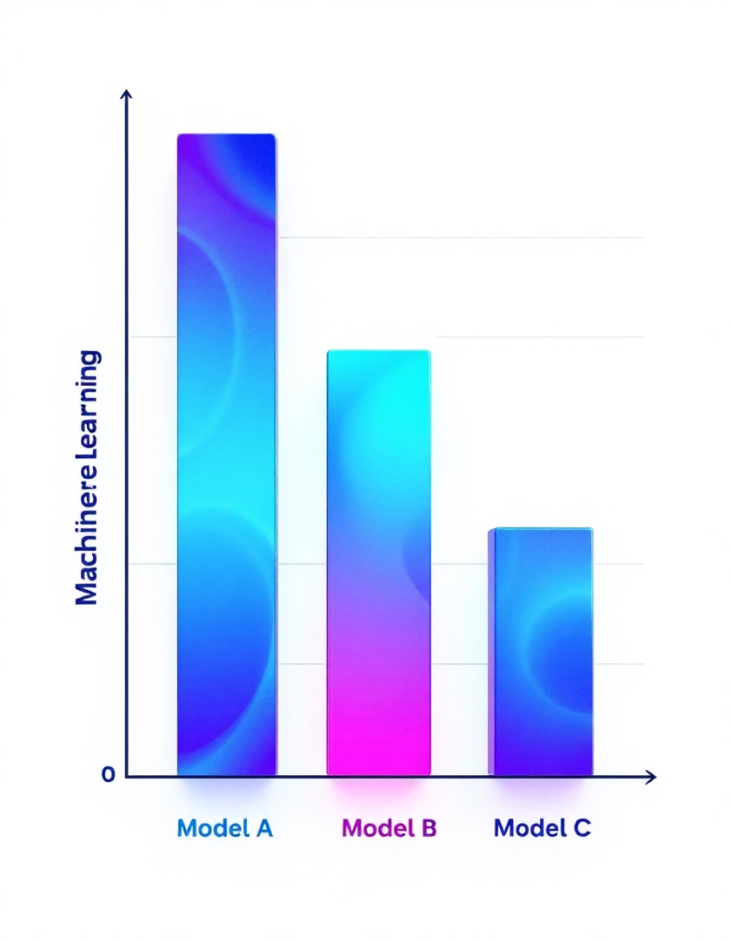
Top Performing Models and Metrics
Gradient Boosting
202.507449
246.838441
0.973564
Random Forest
214.815076
270.156905
0.968333
Linear Regression
238.031992
325.734444
0.953964
Ridge Regression
238.160276
326.143177
0.953848
Gradient Boosting and Random Forest models show superior performance. They minimize Mean Absolute Error (MAE) and Root Mean Squared Error (RMSE). Their R2 scores indicate a high degree of variance explained. This demonstrates their effectiveness in solar forecasting.

Slide 6








Implementation Process
Cleaning & Prep
Data Collection
Pre-process data and engineer features.
Gather raw data from various sources.
Model Training
Validation
Train models with optimized parameters.
Evaluate performance on unseen data.
The implementation involves a systematic workflow. Specialized models handle zero-inflated solar data for better accuracy. Time series and power transformation methods further improve seasonal predictions. This ensures robust and reliable forecasting.

Slide 7

Real-World Impact & Deployment
Optimize Operations
Reduce Costs
Improve Reliability
Real-time ML predictions help optimize energy operations.
Prediction systems significantly reduce operational costs.
Increased grid reliability and efficiency are key benefits.
Deployed models assist with day-ahead and hour-ahead solar management. This allows for proactive decision-making and resource allocation. The tangible benefits include cost savings and enhanced stability for energy providers.

Slide 8

Summary & Future Directions
99%
1
3
AUC Achieved
Enhanced Accuracy
Future Research
Machine learning achieves high accuracy for solar prediction.
Integrating AQI and time series techniques boosts results.
Deep learning and hybrid models promise greater accuracy.
ML models demonstrate exceptional performance in solar energy forecasting. Continued research in advanced deep learning and hybrid models aims to push the boundaries of predictive accuracy even further. This will lead to even more efficient and sustainable energy systems.

Slide 9
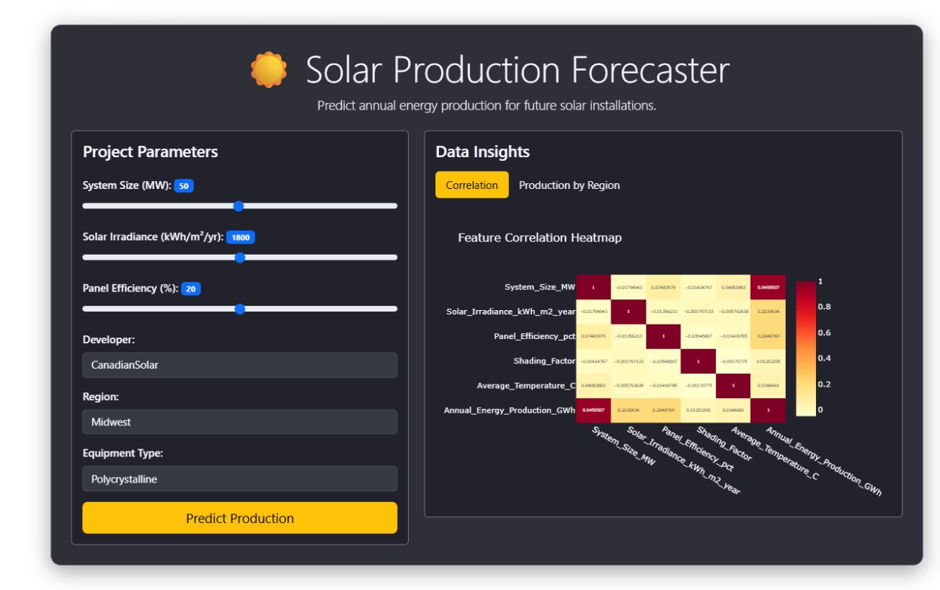
Deployment
"Solar Production Forecaster" application interface with: Left side: - Project parameters including System Size (kW), Solar Irradiance, and Panel Efficiency (%) - Input fields for Developer, Region, Material, and Equipment Type (Polycrystalline) - A yellow "Predict Production" button Right side: - Data insights section with tabs for "Comparison" and "Production by Region" - A feature correlation heatmap showing relationships between various solar parameters - The heatmap uses color intensity to indicate correlation strength between factors like system size, solar irradiance, panel efficiency, and other production variables This appears to be a tool for predicting solar energy production for installations based on various parameters and their relationships.

